Slide 1
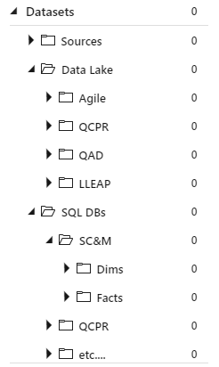
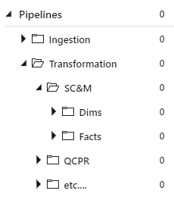
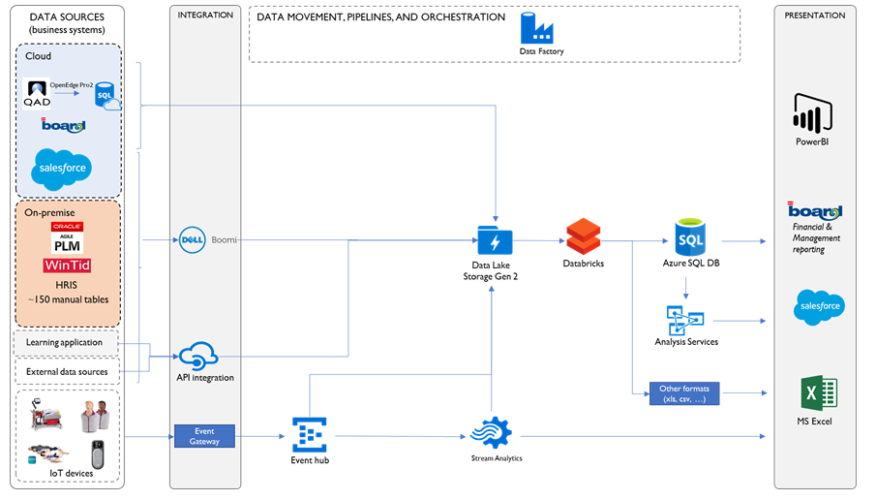
Suggestions
Define Primary Keys and Foreign Key in Dims and Facts in ASQLDB
You’ll catch data integrity issues already here
Moreover, follow a naming convention so that it’s easy to connect them together in AS-model. E.g. all PKs and FKs use “_Id”, that will distinguish them from business attributes that have “Id” in them.
Folder structure in ADF
Search function is good, but nevertheless let’s use folders so it’s easier to find (similar) objects

Slide 2
Naming conventions
Datasets
Not a fan of «in_»/«out_» prefix since this is a matter of perspective. A dataset that is output in one pipeline, might be input in another. Right now all pipelines «starts» at the data lake and «ends» in ASQLDB, but maybe that’s not true «tomorrow»
should be sufficient with something that declares where it’s placed/stored (e.g. DL, ASQL etc.):
Suggestion: <adf_type>_<resource_type>_<origin(if DL)>_<specific_name>
E.g. in_df_ds_adls_qad_code_mstr -> ds_adls_qad_code_mstr
Pipelines
Right now pipelines have environment present in the name (via e.g. name of ASQL resource – «badevdb»). Make names agnostic to environment so that it can have the same name everywhere?
Suggestion: <adf_type>_<pipeline_type>_<domain_of_source>_< domain_of_target>_<specific_name>
E.g. pipe_cp_adls_badevdb_DimCurrency -> pipe_trans_adls_badb_DimCurrency
Data Flows
Make it agnostic to environment
Suggestion: <adf_type>_<domain_of_source>_< domain_of_target>_<specific_name>
E.g. df_adls_badevdb_DimCurrency -> df_adls_badb_DimCurrency

Slide 3
Suggestions cont.
Parameterize as much as possilbe to reduce hardcoding and highlight important business rules
Not sure where to store these parameters, but the idea is to have them «one place» and then read them as input where you need them
Azure Key vault?
Right now I find hardcoded passwords directly in the code, it seems this can be mitigated by Azure Key Vault, but need to check details (pricing, perfomance etc.)
Dimension for units?
Reduce ambiguity of all measures that have an implicit connection to a unit.
E.g.: FactInventoryLocation.Weight -> FactInventoryLocation.Weight FactInventoryLocation.Unit_Id_Weight FactInventoryLocation.Volume -> FactInventoryLocation.Volume FactInventoryLocation.Unit_Id_Volume
Clean up obsolete ADF objects (pipelines and datasets)
mostly related to copy activities from source to Data lake

